Slide 1

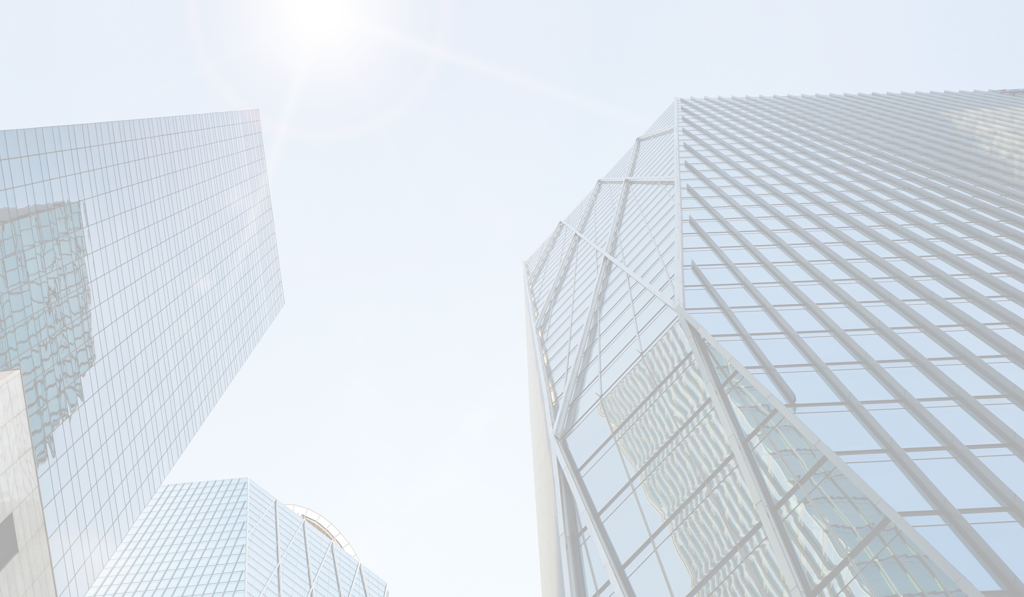
CONTEMPORARY WORLD
Dr. Jackelyn L. Legaspi
PROFESSOR

Slide 2
Quiz 1: Impacts of Globalization
TRUE OR FALSE
Globalization has increased economic growth globally but widened income inequality within many nations.
Cultural exchange due to globalization has preserved all indigenous traditions worldwide.
Globalization has led to cultural homogenization, where local cultures adapt or merge with dominant ones.
Developing countries always benefit economically from globalization.
Multinational corporations shape political and economic dynamics in globalization.
Globalization has decreased environmental resource consumption worldwide.
The spread of technology through globalization has improved access to healthcare in remote areas.
Political power dynamics in globalization often favor economically dominant nations.
Globalization has made it easier for governments to enforce environmental regulations.
The global flow of information has strengthened democratic movements in many regions.
Globalization has led to overexploitation of natural resources in certain regions.
Increased global trade has reduced carbon emissions worldwide.
The outsourcing of labor has created economic opportunities in developing countries.
Globalization has contributed to the loss of indigenous languages.
Globalization has eliminated the digital divide between rich and poor countries.

Slide 3

METAPHOR OF
GLOBALIZATION

Slide 4
Metaphors is said to be a figure of speech that describes an object or action. Therefore, when we talk about metaphors of globalization we are referring to certain concepts that describes and links the presence of globalization in the world today. It relates to the conditions that take place among states in the exercise and implementation of globalization.

Slide 5
METAPHOR OF
GLOBALIZATION

Slide 6
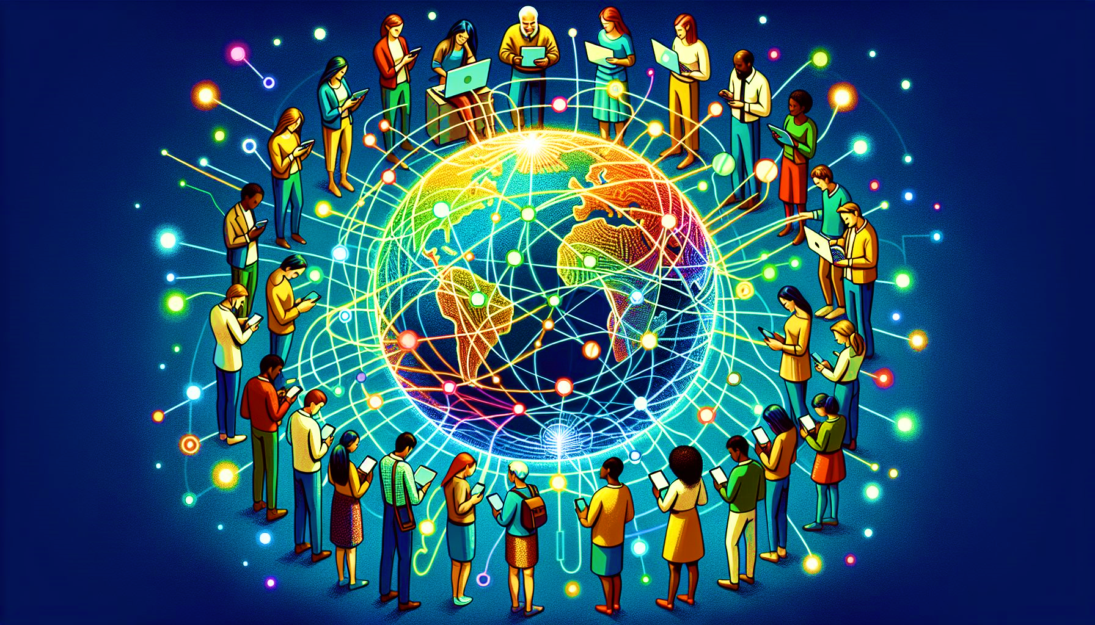
"The Global Village"
This metaphor, popularized by Marshall McLuhan, likens the world to a small village where advancements in communication and transportation make distant places feel closer and more interconnected.
Example: A person in Kenya video-calling someone in Canada to collaborate on a project demonstrates how global connectivity mimics the intimacy of a village.

Slide 7
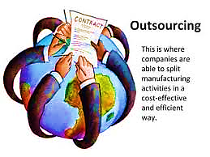
"Flattening the World"
Coined by Thomas Friedman in The World is Flat, this metaphor describes the leveling of the playing field in global commerce and communication, where barriers to competition are reduced.
Example: Outsourcing jobs from the U.S. to India for software development due to technological and cost advantages.(ex call center)

Slide 8
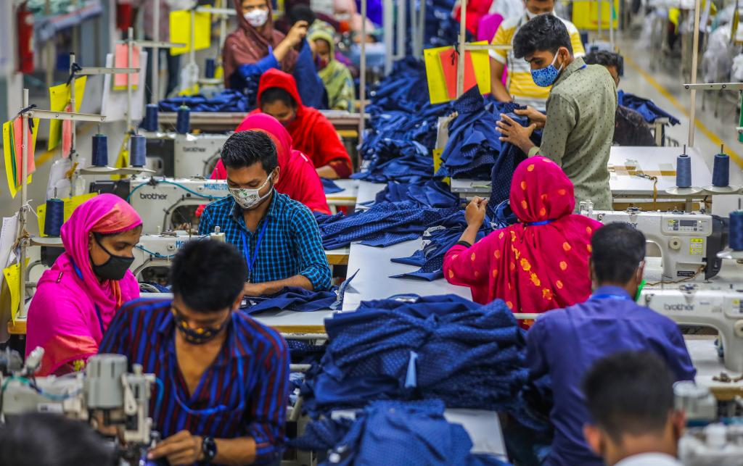
"Globalization as a Tapestry"
This metaphor illustrates how different cultures, economies, and societies are interwoven to create a rich, interconnected fabric of global interactions.
Example: The fashion industry combines Italian design, Chinese manufacturing, and global online retail platforms to deliver products worldwide.

Slide 9
The metaphor of "flow" in globalization describes the dynamic and continuous movement of people, goods, ideas, capital, and information across borders. It emphasizes the interconnected and fluid nature of global exchanges, where boundaries are increasingly less restrictive.

Slide 10
Friction contrasts with metaphors like "flow," suggesting that while globalization connects the world, it also faces resistance—such as trade restrictions, cultural clashes, political tensions, and environmental concerns.

Slide 11
Cultural Friction When global businesses expand, they sometimes clash with local customs, values, or traditions.
Example: Fast-food chains like McDonald's face backlash in some countries for promoting Western-style diets, which can be perceived as eroding local culinary traditions and contributing to health issues like obesity.

Slide 12
Environmental Friction Globalization often leads to environmental degradation, sparking resistance from local communities and activists.
Example: Large-scale mining projects by multinational corporations in the Amazon face opposition from indigenous groups concerned about deforestation, water contamination, and loss of biodiversity.

Slide 13
Connectivity focuses on the infrastructure and systems that enable global interactions, like the internet, trade networks, financial systems, and travel. It suggests that globalization is like a web or a network where everything is interconnected, allowing the exchange of goods, ideas, and experiences.

Slide 14
Global Digital Connectivity
The widespread use of the internet and platforms like Zoom, WhatsApp, and social media exemplifies connectivity in globalization.
Example: During the COVID-19 pandemic, universities worldwide adopted online platforms for remote learning. A professor in the U.K. could teach students in India, Brazil, and Nigeria simultaneously, enabling education to continue across borders despite physical restrictions.

Slide 15
Transportation Networks
Air travel and shipping routes have made global mobility more accessible.
Example: A tourist can book a flight from Paris to Bali and arrange accommodations online, showcasing how transportation and digital networks connect distant places effortlessly.

Slide 16
Globalization is not just about interconnectedness but also about who holds the POWER to shape and direct global flows of goods, ideas, capital, and policies. Power in globalization can manifest through economic dominance, cultural influence, political decisions, or technological control. This metaphor underscores the hierarchies and imbalances created by globalization processes.

Slide 17
Economic Power
Large multinational corporations (MNCs) wield immense influence in shaping global markets and local economies.
Example: Amazon's dominance in global e-commerce enables it to set market trends, dictate terms to suppliers, and significantly influence consumer behavior worldwide. Its scale can outcompete local retailers, shifting economic power away from smaller players.

Slide 18
Technological Power
Countries or companies that control critical technologies hold disproportionate power in globalization.
Example: The dominance of U.S.-based tech giants like Google, Microsoft, and Apple in global technology markets gives these companies significant control over data, digital infrastructure, and the flow of information worldwide.

Slide 19
Individual Activity: "Exploring Globalization through Metaphor Stories“
Activity Title:"My Metaphor, My Globalization Story“
Objective:
Develop an individual understanding of globalization metaphors.
Relate metaphors to personal experiences or real-world examples.
Foster critical thinking and creative expression.

Slide 20
Instructions:
Introduction (5 minutes):
Reflect on the metaphors of globalization: Global Village, Flattening the World, Global Tapestry, Flow, Friction, Connectivity, and Power.
Choose one metaphor that resonates the most with you or sparks your curiosity.
Task (30 minutes):
1. Draw something that will symbolize your creative story about metaphors of Globalization.
Write a creative story, essay, or journal entry centered on the chosen metaphor.
Your piece should:
Explain what the metaphor means in your own words.
Relate it to a personal experience, a historical event, or a real-world phenomenon.
Highlight its implications, such as benefits, challenges, or its influence on society or individuals.
3. Story Time!
Be ready to share your story with your classmates.

